Slide 1




Hospital Management System: SQL & Tableau Case Study
By Prachi Dalvi
LinkedIn: https://www.linkedin.com/in/prachi-dalvi-9465b0105/
GitHub: https://github.com/prachidalvi

Slide 2

Project Overview
Objective: Analyze hospital operations, patient engagement, and revenue trends using SQL and Tableau.
Dataset: 5 tables - Patients, Doctors, Appointments, Treatments, Billing.
Goals:
Understand patient demographics & retention
Evaluate doctor performance & specialization
Measure appointment efficiency
Analyze revenue flow & insurance impact
Tools: SQL Server | Excel | Tableau

Slide 3


Verified referential integrity between tables.
Ensured correct date sequences (registration < appointment < treatment < billing).
Checked for missing, duplicate, and inconsistent values.
Validated categorical field accuracy (gender, payment_status, etc.).
Briefly write something about the hospital.
Data Model & Quality Checks
Outcome: Clean, relational dataset ready for SQL analysis and visualization.

Slide 4

SQL Analysis Framework
Queries focused on
Patient Insights
Doctor Performance & Revenue
Appointment Efficiency & Conversion
Financial Analysis & Billing Patterns
SQL tools used: Joins, Window Functions, Aggregations, Subqueries.

Slide 5
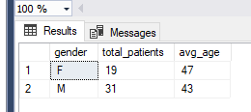

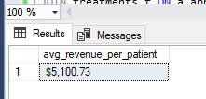
Patient distribution and average age by gender
SELECT
gender,
COUNT(*) AS total_patients,
ROUND(AVG(DATEDIFF(YEAR, date_of_birth, GETDATE())), 0) AS avg_age
FROM patients
GROUP BY gender;
1
Patient Insights
Average Revenue per Patient (ARPP)
SELECT
FORMAT(ROUND(SUM(b.amount) * 1.0
/ COUNT(DISTINCT p.patient_id), 2), 'C', 'en-US') AS avg_revenue_per_patient
FROM billing b
JOIN patients p ON b.patient_id = p.patient_id
WHERE b.payment_status = 'Paid';

Slide 6
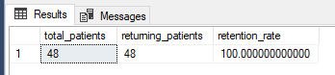
Patient Retention & Visit Frequency
SELECT COUNT(*) AS total_patients,
SUM(CASE WHEN visit_count > 1 THEN 1 ELSE 0 END) AS returning_patients,
ROUND(SUM(CASE WHEN visit_count > 1 THEN 1 ELSE 0 END) * 100.0 / COUNT(*), 2) AS retention_rate
FROM (
SELECT patient_id, COUNT(*) AS visit_count
FROM appointments
GROUP BY patient_id
) AS patient_visits;
1
Patient Insights
Average Revenue per Patient (ARPP)
SELECT
FORMAT(ROUND(SUM(b.amount) * 1.0
/ COUNT(DISTINCT p.patient_id), 2), 'C', 'en-US') AS avg_revenue_per_patient
FROM billing b
JOIN patients p ON b.patient_id = p.patient_id
WHERE b.payment_status = 'Paid';

Slide 7
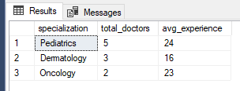

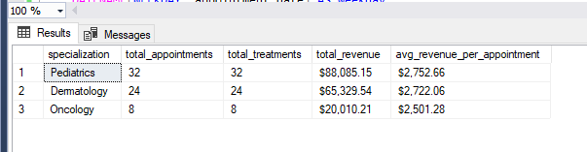
Identify top specializations and experience levels.
SELECT
specialization,
COUNT(*) AS total_doctors,
ROUND(AVG(years_experience),1) AS avg_experience
FROM doctors
GROUP BY specialization
ORDER BY total_doctors DESC;
Doctor’s Performance & Revenue
1
Doctor Workload vs Revenue
SELECT
d.specialization,
COUNT(DISTINCT a.appointment_id) AS total_appointments,
COUNT(DISTINCT t.treatment_id) AS total_treatments,
FORMAT(sum(b.amount), 'C', 'en-US') AS total_revenue,
FORMAT(ROUND(SUM(b.amount) / NULLIF(COUNT(DISTINCT a.appointment_id), 0), 2), 'C', 'en-US') AS avg_revenue_per_appointment
FROM doctors d
JOIN appointments a ON d.doctor_id = a.doctor_id
JOIN treatments t ON a.appointment_id = t.appointment_id
JOIN billing b ON t.treatment_id = b.treatment_id
WHERE b.payment_status = 'Paid'
GROUP BY d.specialization
ORDER BY avg_revenue_per_appointment DESC;

Slide 8
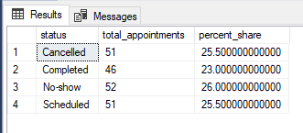

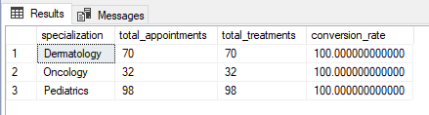
Measure completion and cancellation rates.
Appointment Efficiency & Conversion
SELECT status, COUNT(*) AS total_appointments,
ROUND(COUNT(*) * 100.0 / (SELECT COUNT(*) FROM appointments), 2) AS percent_share
FROM appointments
GROUP BY status;
1
Appointment-to-Treatment Conversion Rate by Specialization
SELECT d.specialization, COUNT(DISTINCT a.appointment_id) AS total_appointments,
COUNT(DISTINCT t.treatment_id) AS total_treatments,
ROUND(COUNT(DISTINCT t.treatment_id) * 100.0 / COUNT(DISTINCT a.appointment_id), 2) AS conversion_rate
FROM appointments a LEFT JOIN treatments t ON a.appointment_id = t.appointment_id
JOIN doctors d ON a.doctor_id = d.doctor_id
GROUP BY d.specialization
ORDER BY conversion_rate DESC;

Slide 9
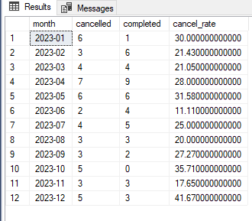
Appointment Timeliness — No-Show / Cancellation Ratio
(Helps identify service quality issues or peak cancellation months.)
Appointment Efficiency & Conversion
1
SELECT
FORMAT(appointment_date, 'yyyy-MM') AS month,
SUM(CASE WHEN status = 'Cancelled' THEN 1 ELSE 0 END) AS cancelled,
SUM(CASE WHEN status = 'Completed' THEN 1 ELSE 0 END) AS completed,
ROUND(SUM(CASE WHEN status = 'Cancelled' THEN 1 ELSE 0 END) * 100.0 / COUNT(*), 2) AS cancel_rate
FROM appointments
GROUP BY FORMAT(appointment_date, 'yyyy-MM')
ORDER BY month;

Slide 10
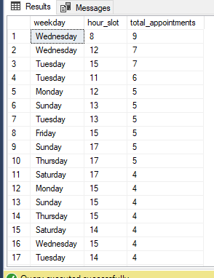
Peak Time & Day Analysis
(Useful for resource planning and scheduling optimization.)
Appointment Efficiency & Conversion
1
SELECT
DATENAME(WEEKDAY, appointment_date) AS weekday,
DATEPART(HOUR, appointment_time) AS hour_slot,
COUNT(*) AS total_appointments
FROM appointments
GROUP BY DATENAME(WEEKDAY, appointment_date), DATEPART(HOUR, appointment_time)
ORDER BY total_appointments DESC;

Slide 11

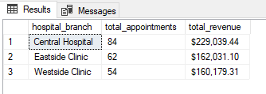
Branch-Level Performance
Financial Analysis & Billing Patterns
SELECT d.hospital_branch, COUNT(DISTINCT a.appointment_id) AS total_appointments,
FORMAT(sum(b.amount), 'C', 'en-US') AS total_revenue
FROM appointments a
JOIN doctors d ON a.doctor_id = d.doctor_id
JOIN treatments t ON a.appointment_id = t.appointment_id
JOIN billing b ON t.treatment_id = b.treatment_id
GROUP BY d.hospital_branch
ORDER BY total_revenue DESC;
1

Slide 12
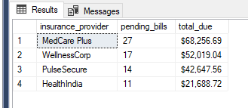
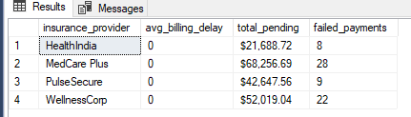
Outstanding Payments by Insurance Provider
Financial Analysis & Billing Patterns
SELECT P.insurance_provider, COUNT(*) AS pending_bills
, FORMAT(sum(b.amount), 'C', 'en-US') AS total_due
FROM patients p inner join billing b on p.patient_id = b.patient_id
where b.payment_status = 'Pending'
group by P.insurance_provider
Order by total_due desc
1
Payment Performance Metrics
SELECT p.insurance_provider,
AVG(DATEDIFF(DAY, t.treatment_date, b.bill_date)) AS avg_billing_delay,
FORMAT(SUM(CASE WHEN b.payment_status = 'Pending' THEN b.amount ELSE 0 END), 'C', 'en-US') AS total_pending,
COUNT(CASE WHEN b.payment_status = 'Failed' THEN 1 END) AS failed_payments
FROM billing b
JOIN treatments t ON b.treatment_id = t.treatment_id
JOIN patients p ON b.patient_id = p.patient_id
GROUP BY p.insurance_provider
ORDER BY avg_billing_delay DESC;

Slide 13
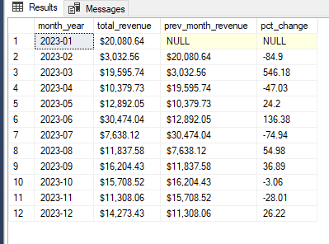
Revenue Trend Analysis
Financial Analysis & Billing Patterns
WITH MonthlyRevenue AS (
SELECT FORMAT(b.bill_date, 'yyyy-MM') AS month_year,
SUM(b.amount) AS total_revenue
FROM billing b
WHERE b.payment_status = 'Paid'
GROUP BY FORMAT(b.bill_date, 'yyyy-MM')
)
SELECT month_year,
FORMAT(total_revenue, 'C', 'en-US') AS total_revenue,
FORMAT(LAG(total_revenue) OVER (ORDER BY month_year), 'C', 'en-US') AS prev_month_revenue,
ROUND(
( (total_revenue - LAG(total_revenue) OVER (ORDER BY month_year)) * 100.0 /
NULLIF(LAG(total_revenue) OVER (ORDER BY month_year), 0) ), 2 ) AS pct_change
FROM MonthlyRevenue
ORDER BY month_year;
1

Slide 14

100% conversion rate from appointments to treatments.
Pediatrics leads in workload and revenue ($88K).
Insurance pending balance: $184K
Stable growth with seasonal fluctuations.
Conclusion & Key Takeaways

Slide 15

Reduce no-shows with automated reminders.
Optimize staffing on Tue/Wed peak hours.
Automate claim tracking and follow-ups.
Expand Oncology & Dermatology services.
Build SQL + Tableau dashboards for real-time KPI tracking.
Future Recommendations

Slide 16

1
Thank you !!!

